Slide 1
Lesson objective
Title: Fractions
Aim – be able to:
Identify elements of a fraction
Identify and create equivalent fractions
Plan:
Terminology and concepts
Fraction wall
Equivalent fractions
Need whiteboards.

Slide 2
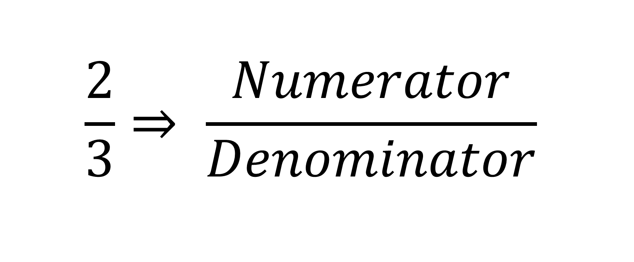
Terminology
$$\frac{2}{3}⇒ \frac{Numerator}{Denominator}$$

Slide 3
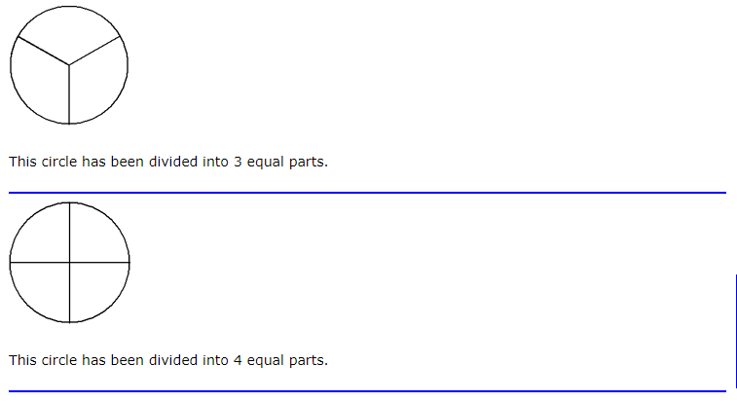

Slide 4
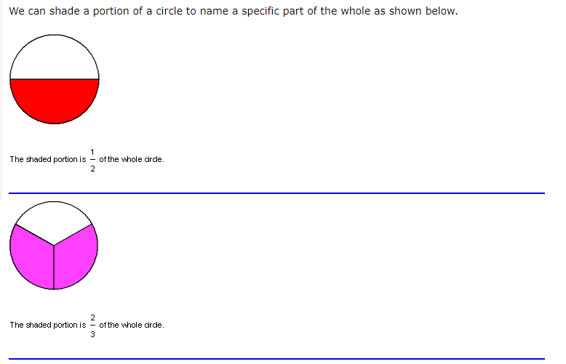

Slide 5
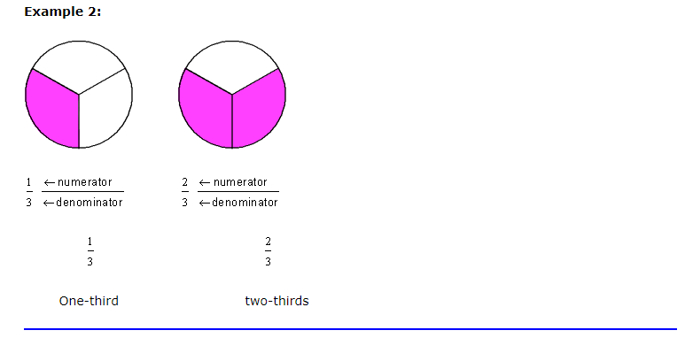

Slide 6
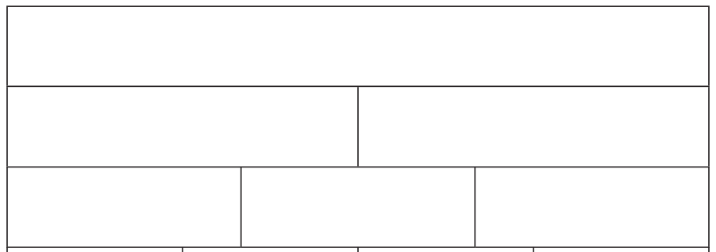
Fraction wall

Slide 7
Creating equivalent fractions
https://www.youtube.com/watch?v=qcHHhd6HizI
Remember: what ever we do to the top number……..

Slide 8
Choral response
Equivalent fractions are equal in value but use different numbers.
Equivalent fractions are _____ in value but use different numbers.
Equivalent fractions are _____ in value but use _______ numbers.
Describe equivalent fractions….

Slide 9


Creating equivalent fractions
I do
We do
$$\frac{3}{4}=$$
$$\frac{5}{7}=$$
$$\frac{4}{6}= \frac{}{18}$$
$$\frac{4}{9}=$$
$$\frac{2}{5}=$$
$$\frac{3}{5}=\frac{12}{}$$
Factor of 2
Factor of 2
Factor of 5
Factor of 5
Factor of ?
Factor of ?

Slide 10
Remember:
We can use ANY factor when creating an equivalent fraction, as long as we multiply BOTH top AND bottom number by the SAME factor.

Slide 11

Whiteboards
Create an equivalent fraction using a factor of 2 (times by 2)
$\frac{4}{5}$
$\frac{2}{10}$
$\frac{3}{7}$

Slide 12

Whiteboards
Create an equivalent fraction using a factor of 3 (times by 3)
$\frac{4}{5}$
$\frac{2}{10}$
$\frac{3}{7}$

Slide 13

Whiteboards
Create an equivalent fraction using a factor of 5
$\frac{4}{5}$
$\frac{2}{10}$
$\frac{3}{7}$

Slide 14

Find the equivalent fraction
Which fraction is equivalent to $\frac{2}{4}$
$\frac{2}{8}$
$\frac{5}{10}$
$\frac{4}{8}$
What are some ways we can check?

Slide 15
Individual task
Fractions work
“fifteen” game

